Slide 1

Project 4 Team 2
Mae Bouazzaoui
Madeline Rondino
Daniel Pulliam
Kayla Blais
Savi Rahiman

Slide 2
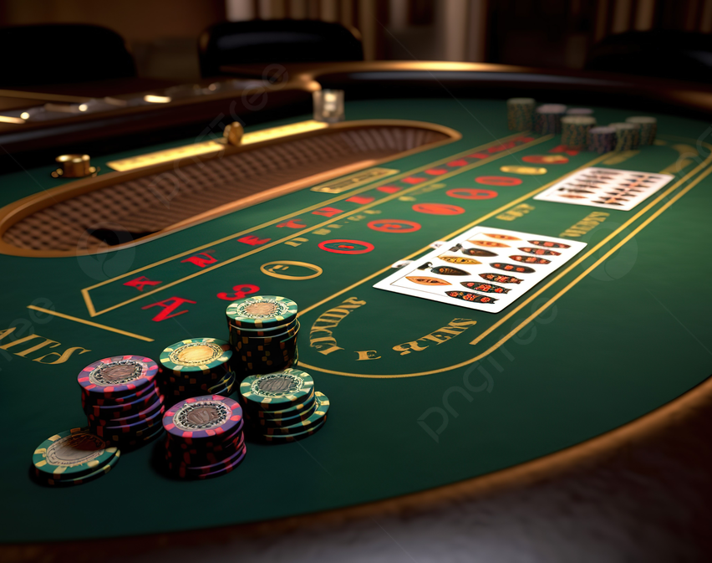
Agenda
Blackjack : How to play - 2-3 rounds demo
Game statistics using SQL and jupyter notebook
Machine learning model
Depending on the sum of the player’s hand, should they hit or should they stay?
Use Cases

Slide 3

Let’s talk Data
Notes:
Data is any collection of facts, numbers, or symbols that can be processed by a computer. It can be in the form of text, images, or videos. Data can be structured or unstructured, depending on the format it is stored in.

Slide 4
Blackjack rules of the game
Objective: The goal of blackjack is to have a hand value closer to 21 than the dealer without exceeding 21. Card Values: Numbered cards are worth their face value, face cards (King, Queen, Jack) are worth 10, and Aces can be worth 1 or 11, depending on the player's choice. Player Actions: Players can either "hit" (take another card) or "stand" (keep their current hand). The player can also "double down" (double the bet and receive one more card). Dealer Rules: The dealer must "hit" until their hand is at least 17. If the dealer exceeds 21, they bust, and players who didn't bust win. Winning: Players win by having a higher hand than the dealer without going over 21 or by the dealer busting. A player with exactly 21 (an Ace and a 10-value card) has a "blackjack" and wins.
Now, who is ready to play?!!!

Slide 5
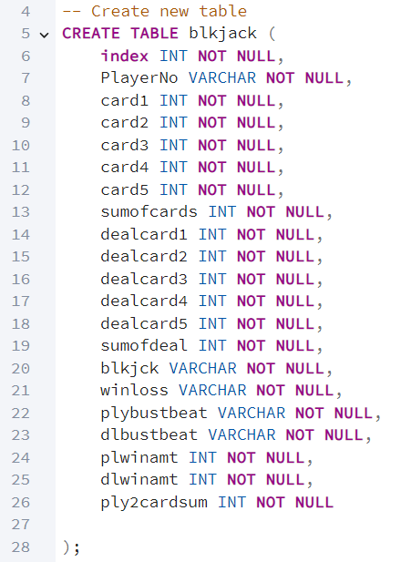
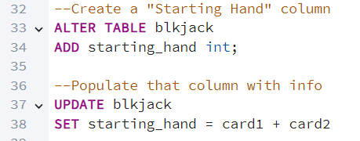
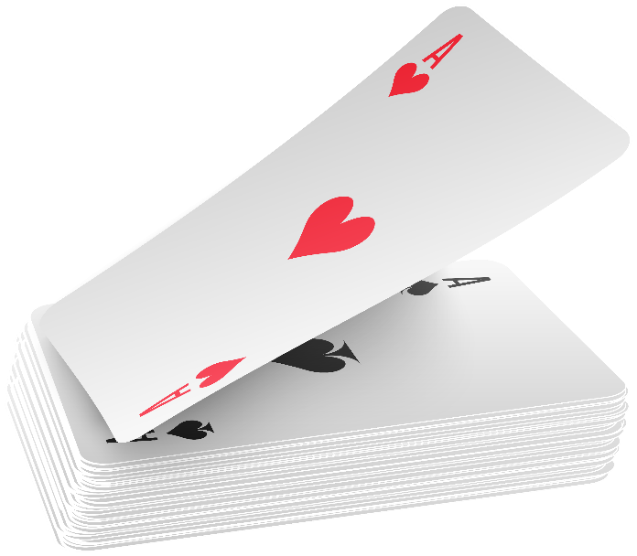
SQL Queries – Table Building
Create table and create new “Starting Hand” column.

Slide 6
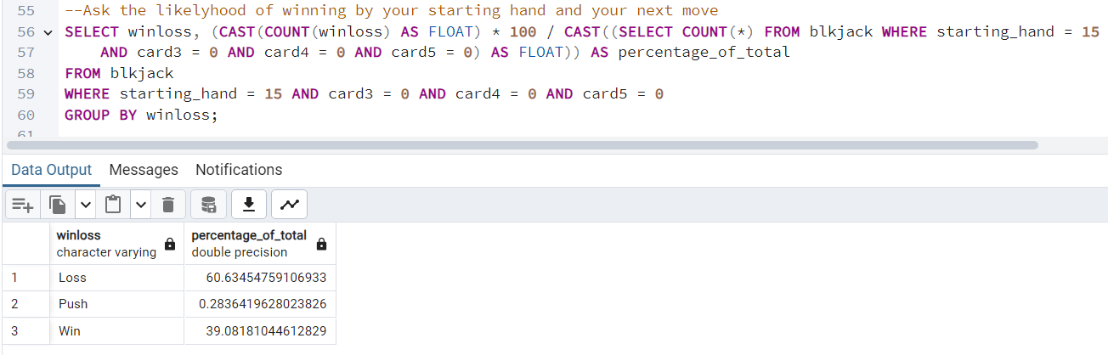

SQL Queries – Starting Hand Statistics
Query to find the likelihood of winning based on your starting hands and next move (hit or stay).

Slide 7
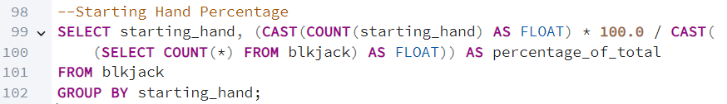
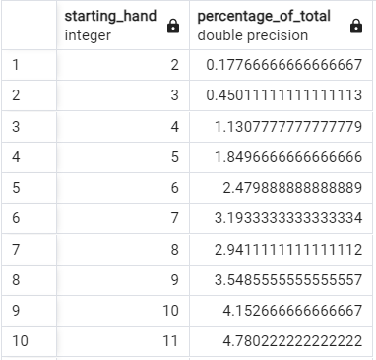
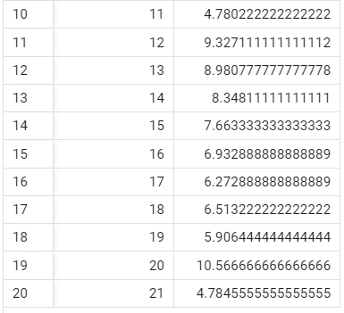
SQL Queries – Other Fun Facts

Slide 8
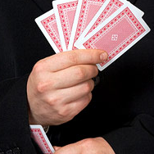
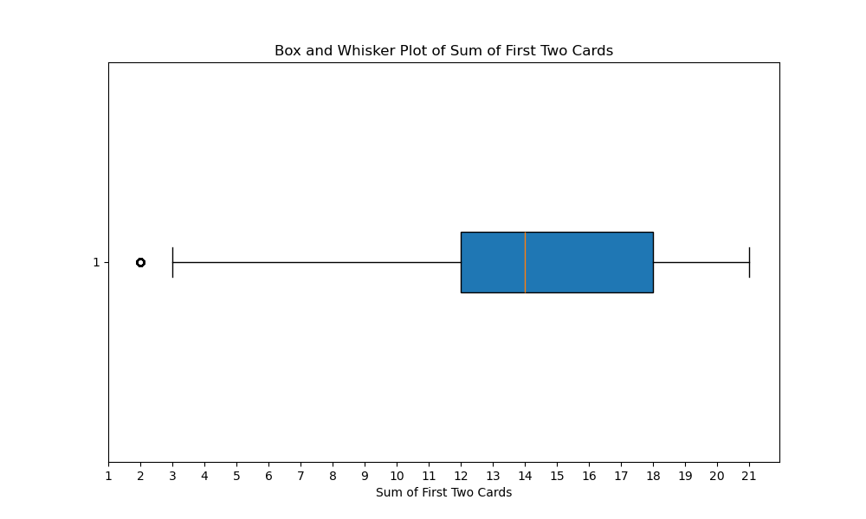
How common is a good first hand
The box and whisker plot shows the distribution of the possible value of your first hand.
You can see that the mean is around a 14.
There is an outlier for a 2. Which would only occur if two Aces are played as 1’s.

Slide 9
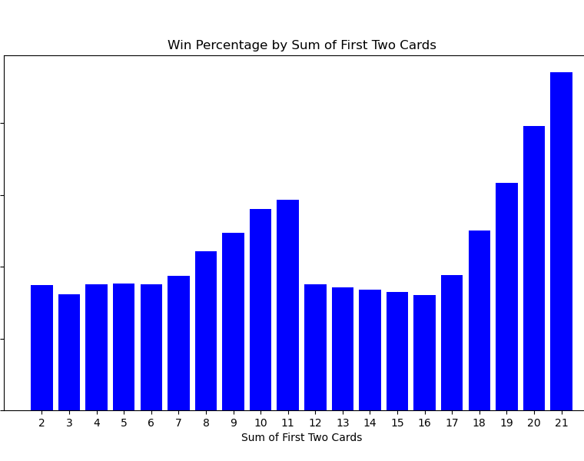
What is best first hand?
The graph shows the most winning first hands.
You can see where a 21 is the best hand.
Notice where it drops off after 11.

Slide 10
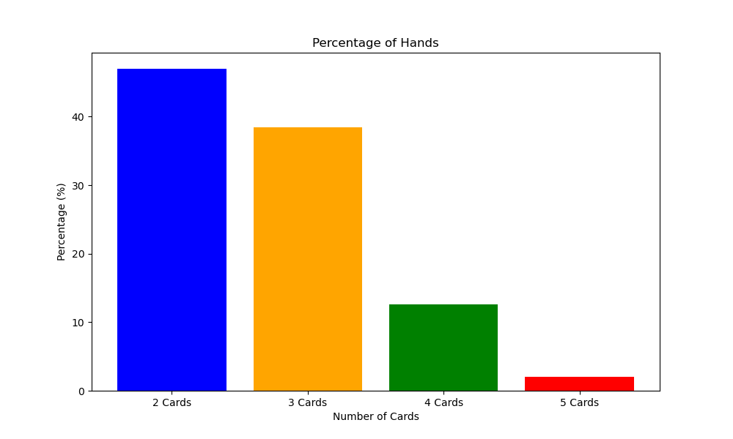
How many hands is the most common?
1 hand is the most common.
It is very rare to play 4 hands.

Slide 11
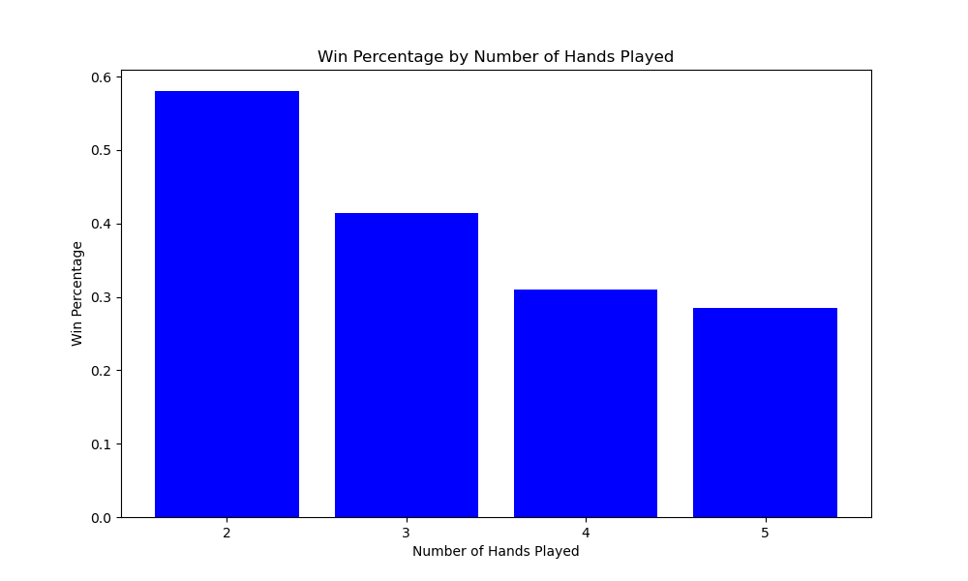
Win percentage by number of hands played
1 hand is the most common to win with.
You can see it becomes less likely to win with the more hands you get.

Slide 12
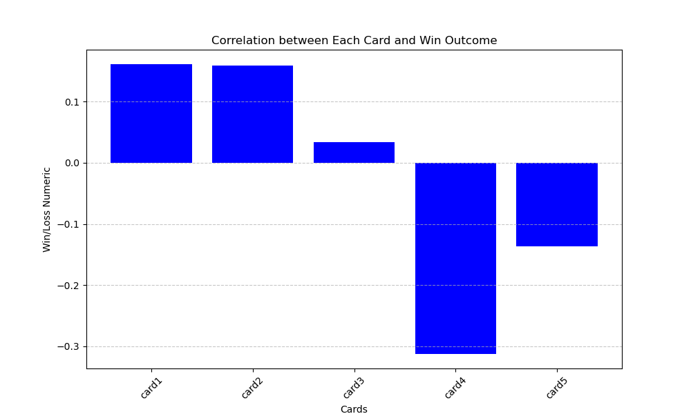
How are hands correlated with wins?
The first hand has the highest positive correlation with wins.
You can see that the 4th card has the highest negative correlation with wins.

Slide 13
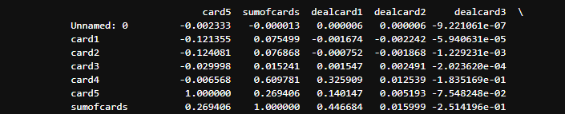
Negative Correlation between players first hand and Dealers First Hand.

Slide 14
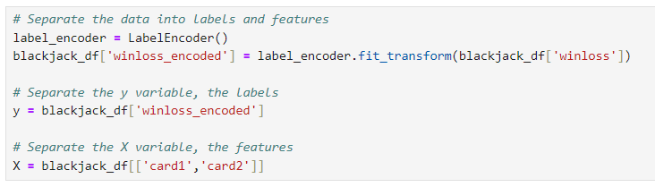
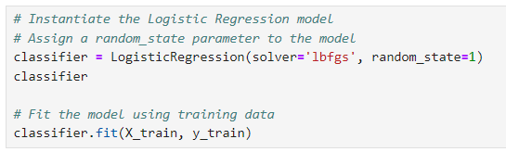
Machine Learning Model
The goal of our machine learning model was to accurately predict whether a player will win or lose a game of blackjack.
Some highlights of the first attempt are displayed here:
The variable we wanted to predict was “winloss”
The way we originally intended to do that was with the players’ starting hand.
Originally, we utilized the Logistic Regression Model to try to predict wins & losses.

Slide 15
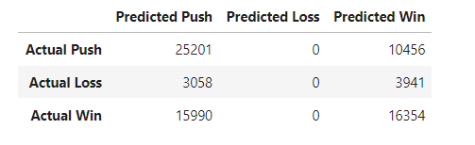
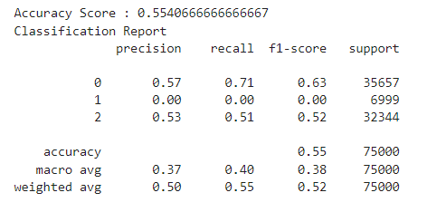
Machine Learning Model
This original approach yielded an overall accuracy score of 55%
Something worth noting with this model is the “Predicted Loss” column.
This particular model could not predict loss at all.

Slide 16
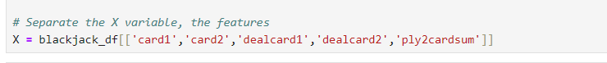
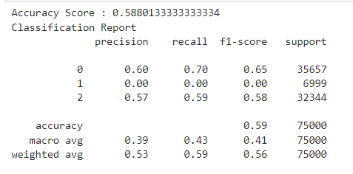
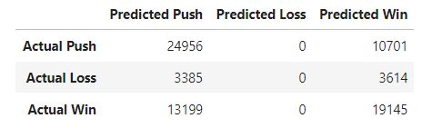
Machine Learning Model
The next approach still utilized the Logistic Regression model, this time adding more features to the X variable.
This attempt uses not only the players’ starting hand, but also the dealer’s.
This model performed better than the original, but still not optimal, at 58% accuracy.
Its important to note, even with the additional features, the model is still not predicting losses whatsoever.

Slide 17
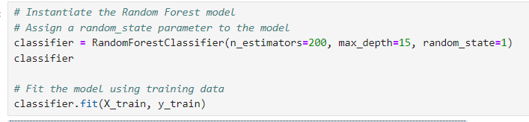
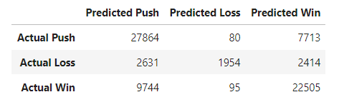
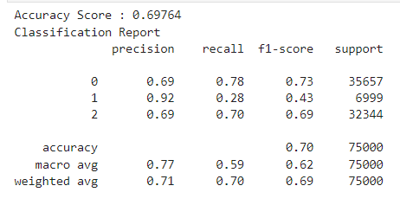
Machine Learning Model
For the final approach, we opted to use the Random Forest model as a means of predicting, leaving the previous features from attempt number 2 the same.
This yielded a model with a 70% accuracy!

Slide 18
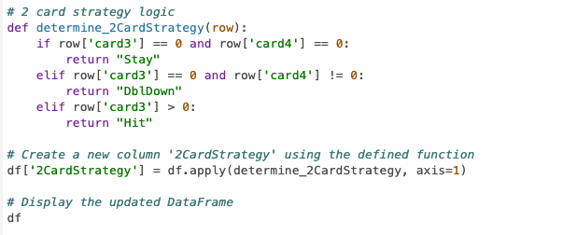
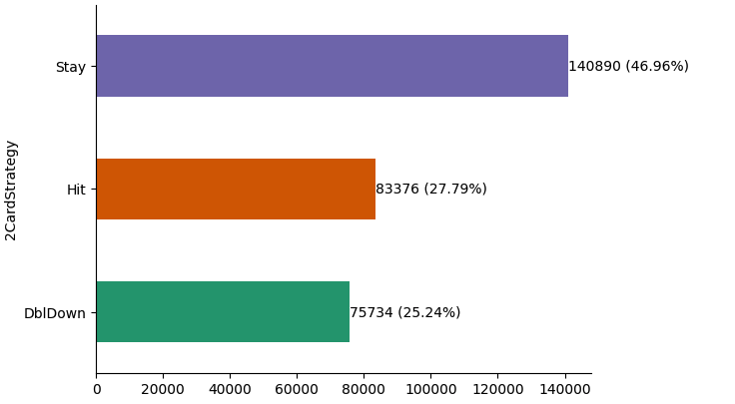
Should I Hit or Should I Stay?
Google Collab Ipython Notebook to create new calculations leveraging the original data set. Calculations included the logic that players used depending on the sum of their cards and the number of hits they requested.
Import dependencies such as
import pandas as pd
import tensorflow as tf
From matplotlib import pyplot as plt
Import seaborn as sns

Slide 19
Use Case
Use SQL, Jupyter Notebook and Tableau to statistically analyze trends, and help refine the machine learning model.
Player Plays a Game
Model Predicts Outcome
Store Game and Prediction in SQL
Visualize in Tableau
Analyze in Jupyter Notebook

Slide 20
Summary
SQL Database: Acts as the central hub for storing game data, player statistics, and model predictions.
Tableau Dashboard: Provides a visual representation of game outcomes, model accuracy, and player behavior.
Jupyter Notebook: Serves as an environment for statistical analysis, experimentation, and model improvement.
Flask API: Connects the prediction model to the game interface for real-time predictions.
**DISCLAIMER** We do not recommend developing this app and taking it to Vegas. Because although counting cards is not illegal, it is highly frowned upon (perfect example the 2008 film “21”)

Slide 21
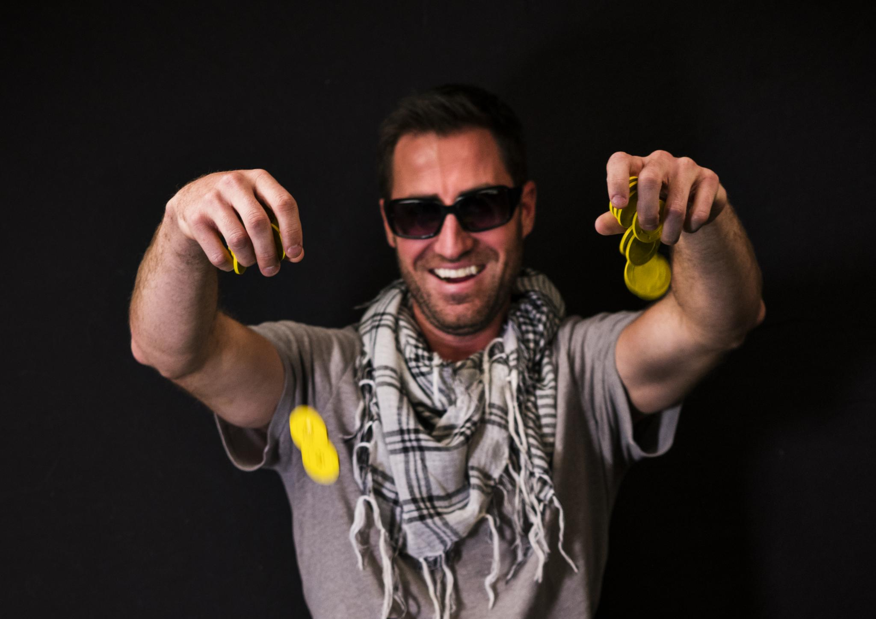
Conclusion
Black Jack is ultimately a game of chance, and even the best strategies can't guarantee a win. While hit or miss analysis can increase your chances of beating the dealer, it is important to remember that each hand is independent and anything could happen.
Notes:
By using hit or miss analysis in Black Jack, you can increase your chances of beating the dealer and walking away with a win. Whether you choose to hit or stand, it's important to remember that Black Jack is ultimately a game of chance, and even the best strategies can't guarantee a win.

